Slide 1
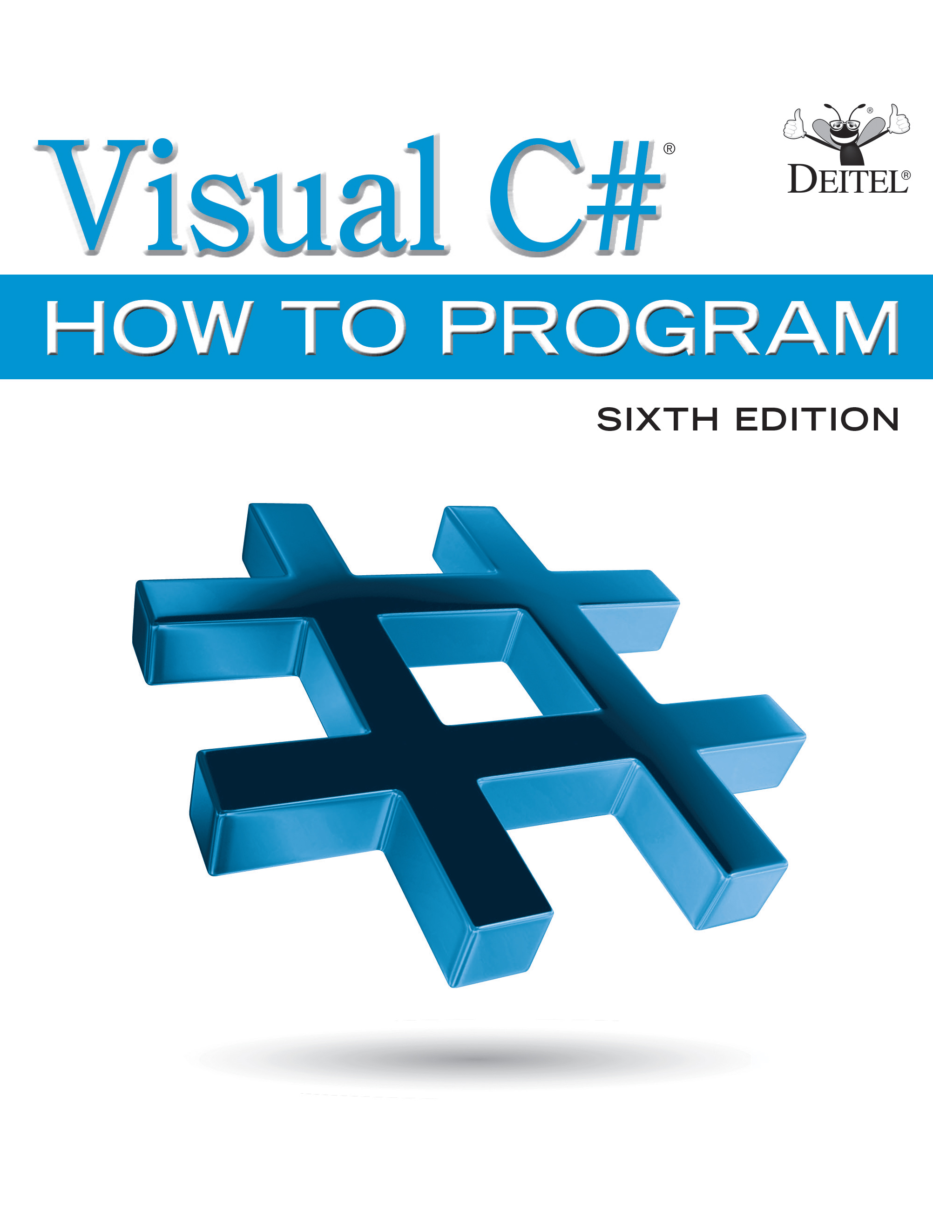
Visual C sharp® How to Program
Sixth Edition
Chapter 11
Object-Oriented Programming: Inheritance
Slides in this presentation contain hyperlinks. JAWS users should be able to get a list of links by using INSERT+F7
Copyright © 2017 Pearson Education, Inc. All Rights Reserved
Notes:
If this PowerPoint presentation contains mathematical equations, you may need to check that your computer has the following installed:
1) MathType Plugin
2) Math Player (free versions available)
3) NVDA Reader (free versions available)

Slide 2
Learning Objectives
Understand how inheritance promotes software reusability.
Create a derived class that inherits attributes and behaviors from a base class.
Override base-class methods in derived classes.
Use access modifier protected to give derivedclass methods access to base-class members.
Access base-class members with base.
Understand how constructors are used in inheritance hierarchies.
See an overview of the methods of class object, the direct or indirect base class of all classes.

Slide 3
Outline (1 of 2)
11.1 Introduction
11.2 Base Classes and Derived Classes
11.3 protected Members
11.4 Relationship between Base Classes and Derived Classes
11.4.1 Creating and Using a CommissionEmployee Class
11.4.2 Creating a BasePlusCommissionEmployee Class without Using Inheritance
11.4.3 Creating a CommissionEmployee–BasePlusCommissionEmployee Inheritance Hierarchy

Slide 4
Outline (2 of 2)
11.4.4 CommissionEmployee BasePlusCommissionEmployee Inheritance Hierarchy Using protected Instance Variables
11.4.5 CommissionEmployee–BasePlusCommissionEmployee Inheritance Hierarchy Using private Instance Variables
11.5 Constructors in Derived Classes
11.6 Software Engineering with Inheritance
11.7 Class object
11.8 Wrap-Up

Slide 5
11.1 Introduction (1 of 3)
Inheritance allows a new class to absorb an existing class’s members.
A derived class normally adds its own fields and methods to represent a more specialized group of objects.
Inheritance saves time by reusing proven and debugged high-quality software.

Slide 6
11.1 Introduction (2 of 3)
The direct base class is the base class which the derived class explicitly inherits.
An indirect base class is any class above the direct base class in the class hierarchy.
The class hierarchy begins with class object.

Slide 7
11.1 Introduction (3 of 3)
The is-a relationship represents inheritance.
For example, a car is a vehicle, and a truck is a vehicle.
New classes can inherit from thousands of pre-built classes in class libraries.

Slide 8
11.2 Base Classes and Derived Classes (1 of 4)
Figure 11.1 lists several simple examples of base classes and derived classes.
Note that base classes are “more general,” and derived classes are “more specific.”

Slide 9
Figure 11.1 Inheritance Examples
Base class | Derived classes
Student | GraduateStudent, UndergraduateStudent
Shape | Circle, Triangle, Rectangle
Loan | CarLoan, HomeImprovementLoan, MortgageLoan
Employee | Faculty, Staff, HourlyWorker, CommissionWorker
SpaceObject | Star, Moon, Planet, FlyingSaucer
BankAccount | CheckingAccount, SavingsAccount

Slide 10
11.2 Base Classes and Derived Classes (2 of 4)
The U M L class diagram of Figure 11.2 shows an inheritance hierarchy representing a university community.
Each arrow represents an is-a relationship.

Slide 11
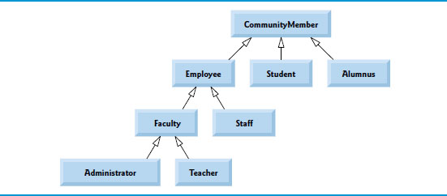
Figure 11.2 Inheritance Hierarchy U M L Class Diagram for University CommunityMembers

Slide 12
11.2 Base Classes and Derived Classes (3 of 4)
Now consider the Shape hierarchy in Figure 11.3.
We can follow the arrows to identify the is-a relationships.

Slide 13
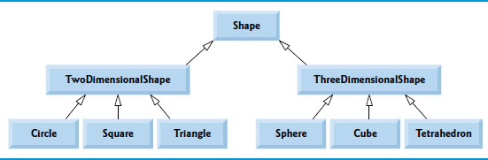
Figure 11.3 U M L Class Diagram Showing an Inheritance Hierarchy for Shapes

Slide 14
11.2 Base Classes and Derived Classes (4 of 4)
Objects of all classes that extend a common base class can be treated as objects of that base class.
However, base-class objects cannot be treated as objects of their derived classes.
A derived class can customize methods it inherits from its base class. In such cases, the derived class can override (redefine) the base-class method with an appropriate implementation.

Slide 15
11.3 protected Members
A base class’s private members are inherited by derived classes, but are not directly accessible by derived-class methods and properties.
A base class’s protected members can be accessed by members of that base class and by members of its derived classes, but not by clients of the class.

Slide 16
Software Engineering Observation 11.1
Properties and methods of a derived class cannot directly access private members of the base class. A derived class can change the state of private base-class fields only through non-private methods and properties provided in the base class.

Slide 17
Software Engineering Observation 11.2
Declaring private fields in a base class helps you test, debug and correctly modify systems. If a derived class could access its base class’s private fields, classes that inherit from that derived class could access the fields as well. This would propagate access to what should be private fields, and the benefits of information hiding would be lost.

Slide 18
11.4.1 Creating and Using a CommissionEmployee Class (1 of 5)
CommissionEmployee (Figure 11.4) represents an employee who is paid a percentage of their sales.

Slide 19
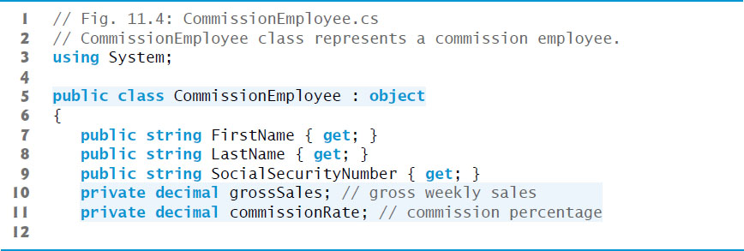
Figure 11.4 CommissionEmployee Class Represents a Commission Employee (1 of 5)

Slide 20
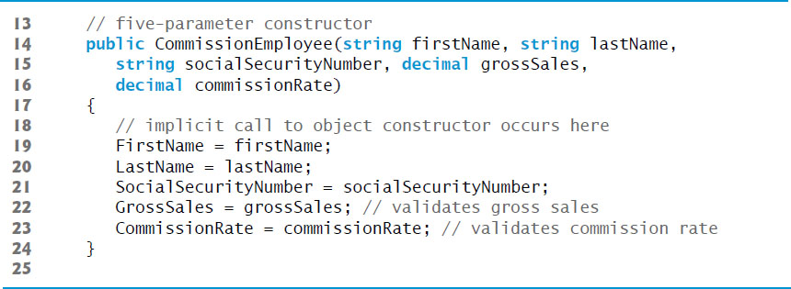
Figure 11.4 CommissionEmployee Class Represents a Commission Employee (2 of 5)

Slide 21
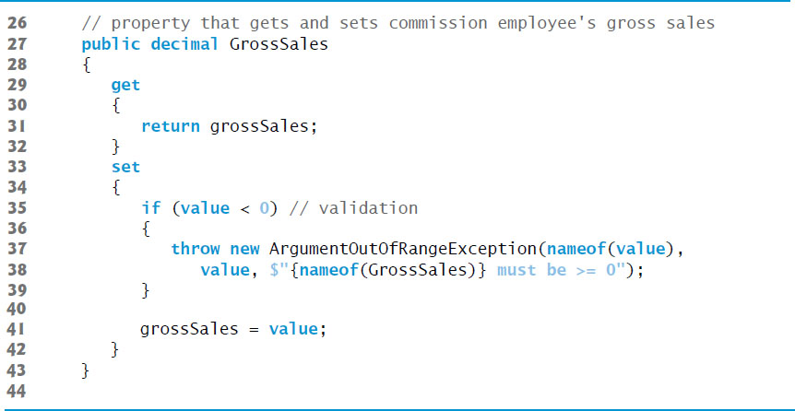
Figure 11.4 CommissionEmployee Class Represents a Commission Employee (3 of 5)

Slide 22
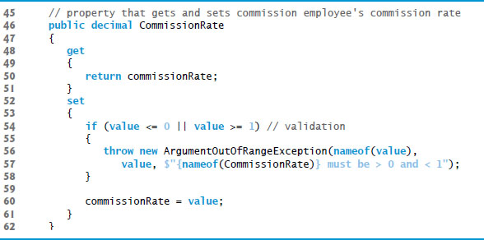
Figure 11.4 CommissionEmployee Class Represents a Commission Employee (4 of 5)

Slide 23
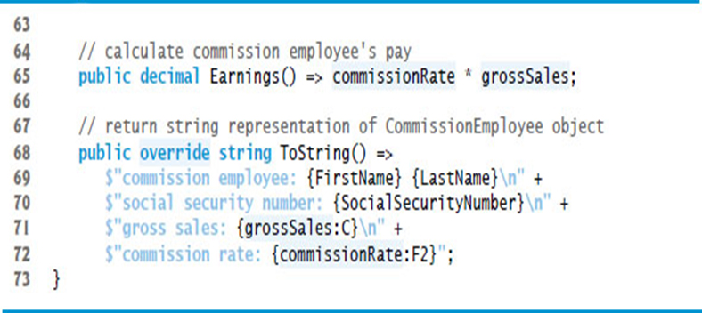
Figure 11.4 CommissionEmployee Class Represents a Commission Employee (5 of 5)

Slide 24
11.4.1 Creating and Using a CommissionEmployee Class (2 of 5)
A colon (:) followed a class name at the end of the class declaration header indicates that the class extends the class to the right of the colon.
Every
class directly or indirectly inherits object’s methods.
If a class does not specify that it inherits from another class, it implicitly inherits from object.

Slide 25
11.4.1 Creating and Using a CommissionEmployee Class (3 of 5)
Declaring instance variables as private and providing public properties to manipulate and validate them helps enforce good software engineering.
Constructors are not inherited.
Either explicitly or implicitly, a call to the base-class constructor is made.
Class object’s default (empty) constructor does nothing.
Even if a class does not have constructors, the default constructor will call the base class’s default or parameterless constructor.

Slide 26
11.4.1 Creating and Using a CommissionEmployee Class (4 of 5)
CommissionEmployee Method ToString
Method ToString is special—it’s one of the methods that every class inherits directly or indirectly from class object.
Method ToString returns a string representing an object.
Class object’s ToString method is primarily a placeholder that typically should be overridden by a derived class.
To override a base-class method, a derived class must declare a method with keyword override.
The method must have the same signature (method name, number of parameters and parameter types) and return type as the base-class method.

Slide 27
Common Programming Error 11.1
It’s a compilation error to override a method with one that has a different access modifier. Overriding a method with a more restrictive access modifier would break the is-a relationship. If a public method could be overridden as a protected or private method, the derived-class objects would not be able to respond to the same method calls as base-class objects. In particular, once a method is declared in a base class, the method must have the same access modifier for all that class’s direct and indirect derived classes.

Slide 28
11.4.1 Creating and Using a CommissionEmployee Class (5 of 5)
Figure 11.5 tests class CommissionEmployee.

Slide 29
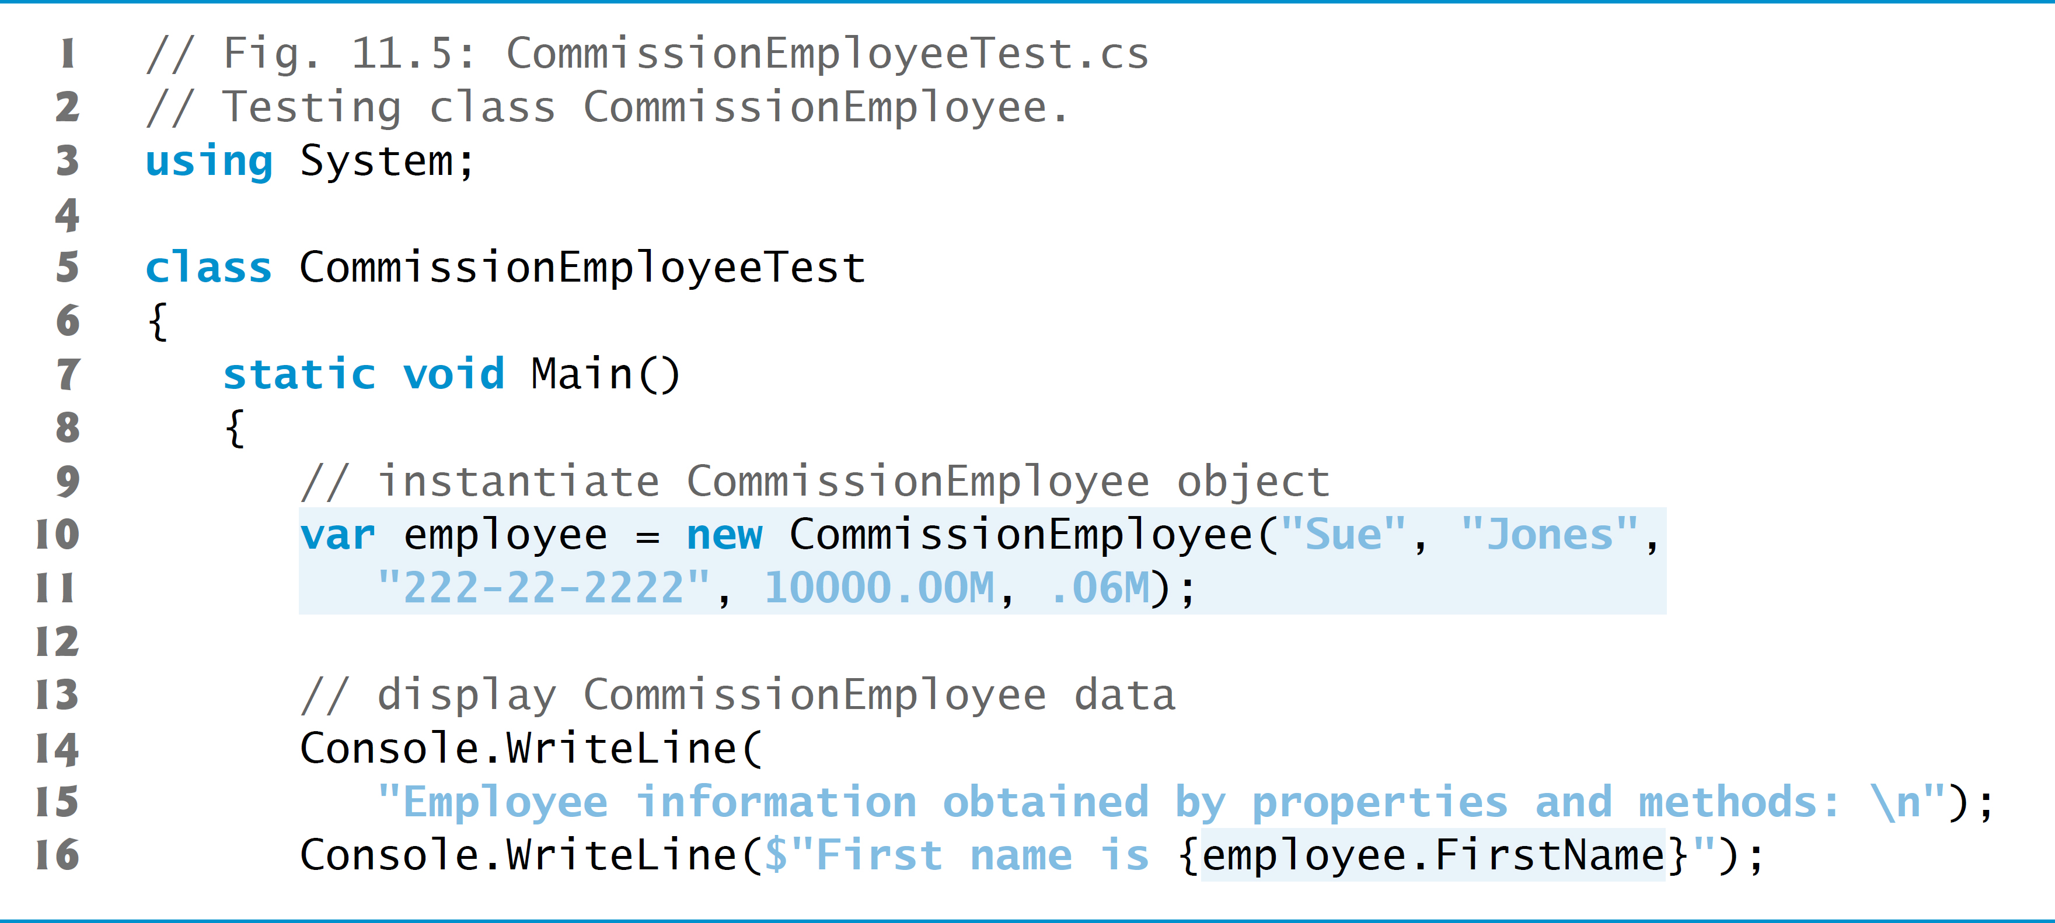
Figure 11.5 Testing Class CommissionEmployee (1 of 3)

Slide 30
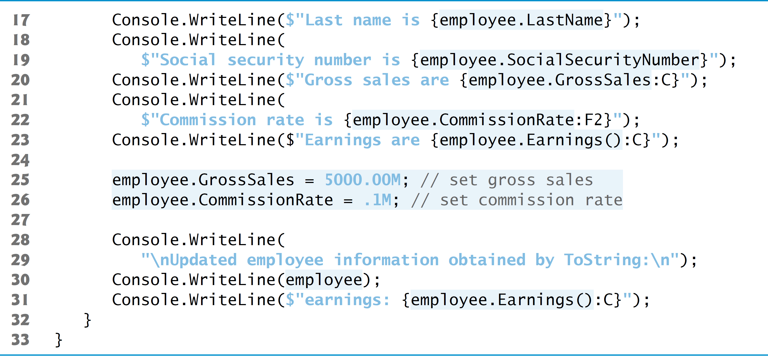
Figure 11.5 Testing Class CommissionEmployee (2 of 3)

Slide 31
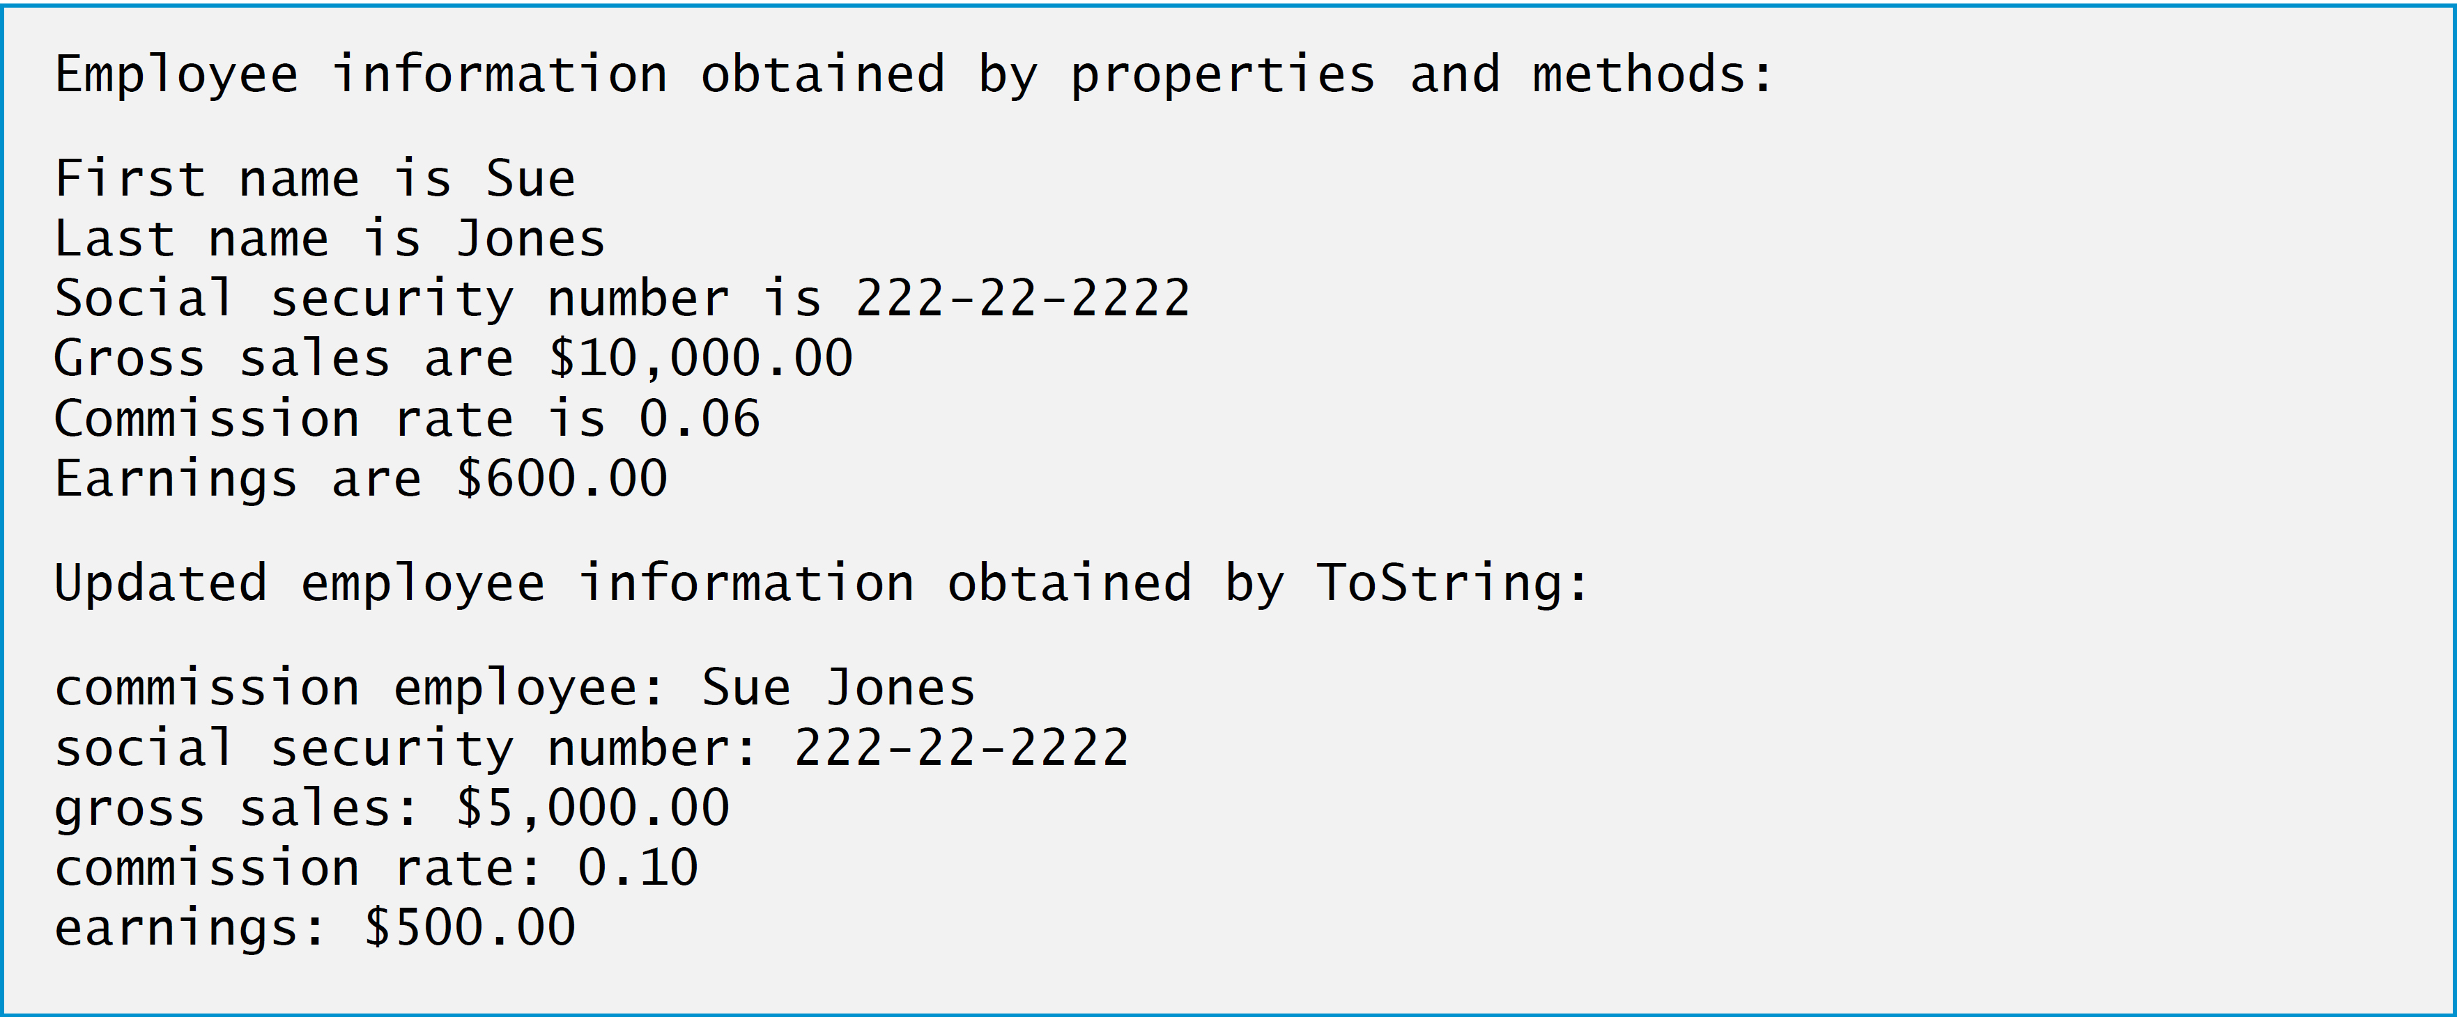
Figure 11.5 Testing Class CommissionEmployee (3 of 3)

Slide 32
11.4.2 Creating a BasePlusCommissionEmployee Class without Using Inheritance (1 of 3)
Class BasePlusCommissionEmployee (Figure 11.6) contains a first name, last name, social security number, gross sales amount, commission rate and base salary—“Base” in the class name stands for “base salary” not base class.

Slide 33
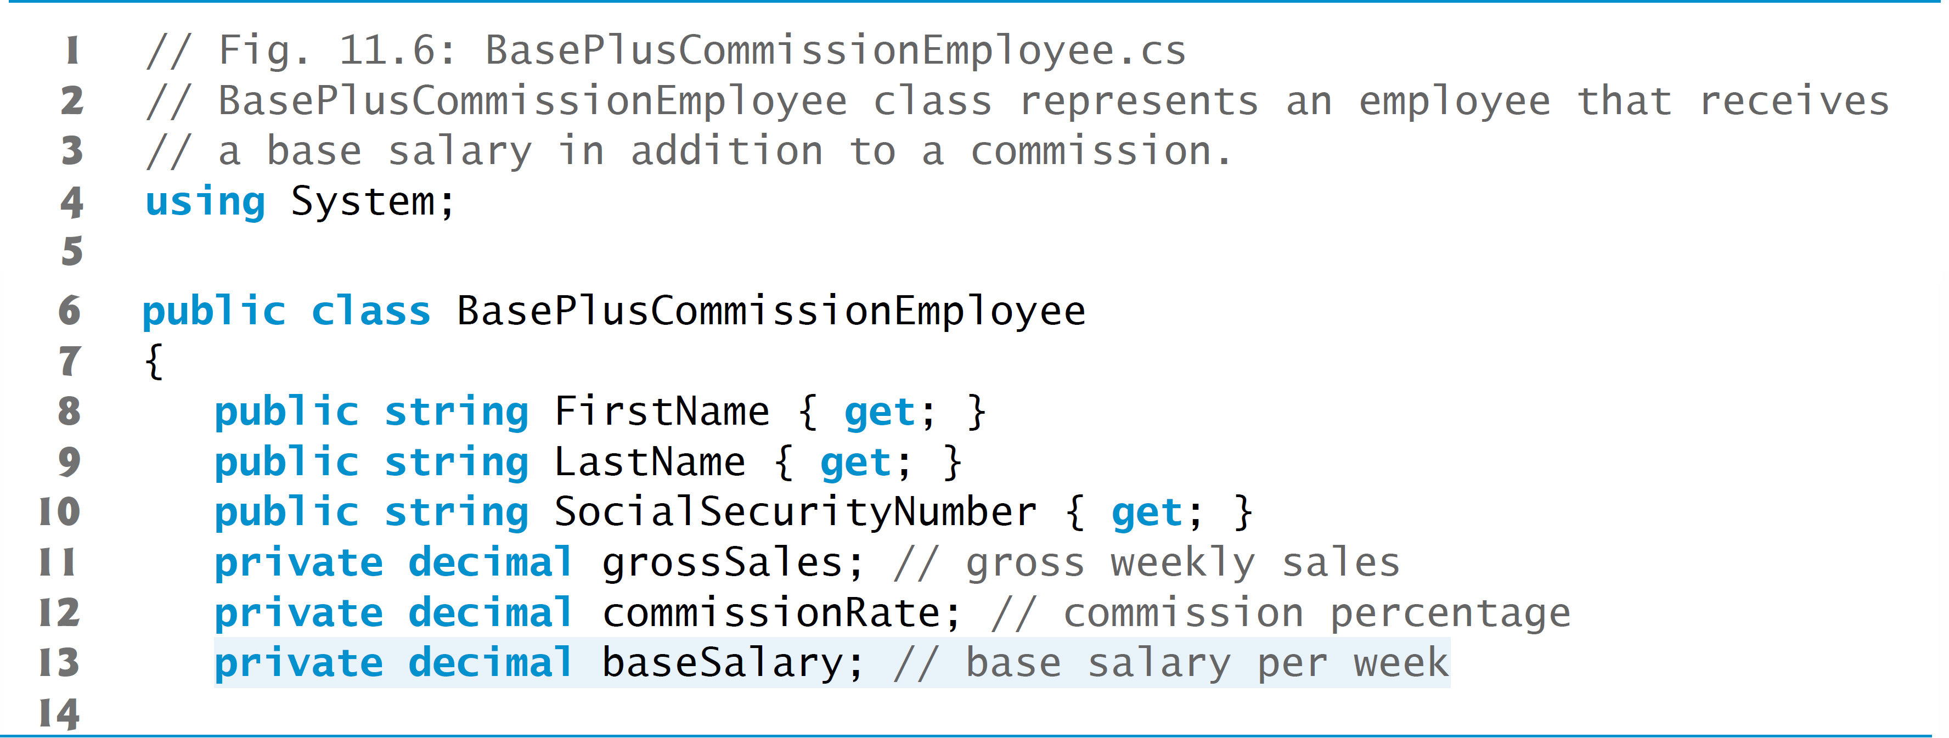
Figure 11.6 BasePlusCommissionEmployee Class Represents an Employee that Receives a Base Salary in Addition to a Commission (1 of 6)

Slide 34
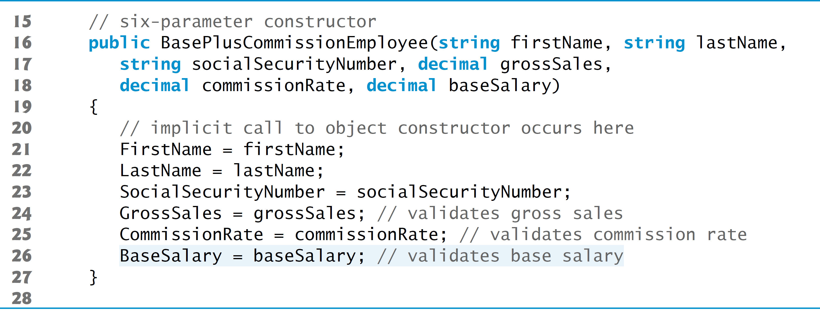
Figure 11.6 BasePlusCommissionEmployee Class Represents an Employee that Receives a Base Salary in Addition to a Commission (2 of 6)

Slide 35
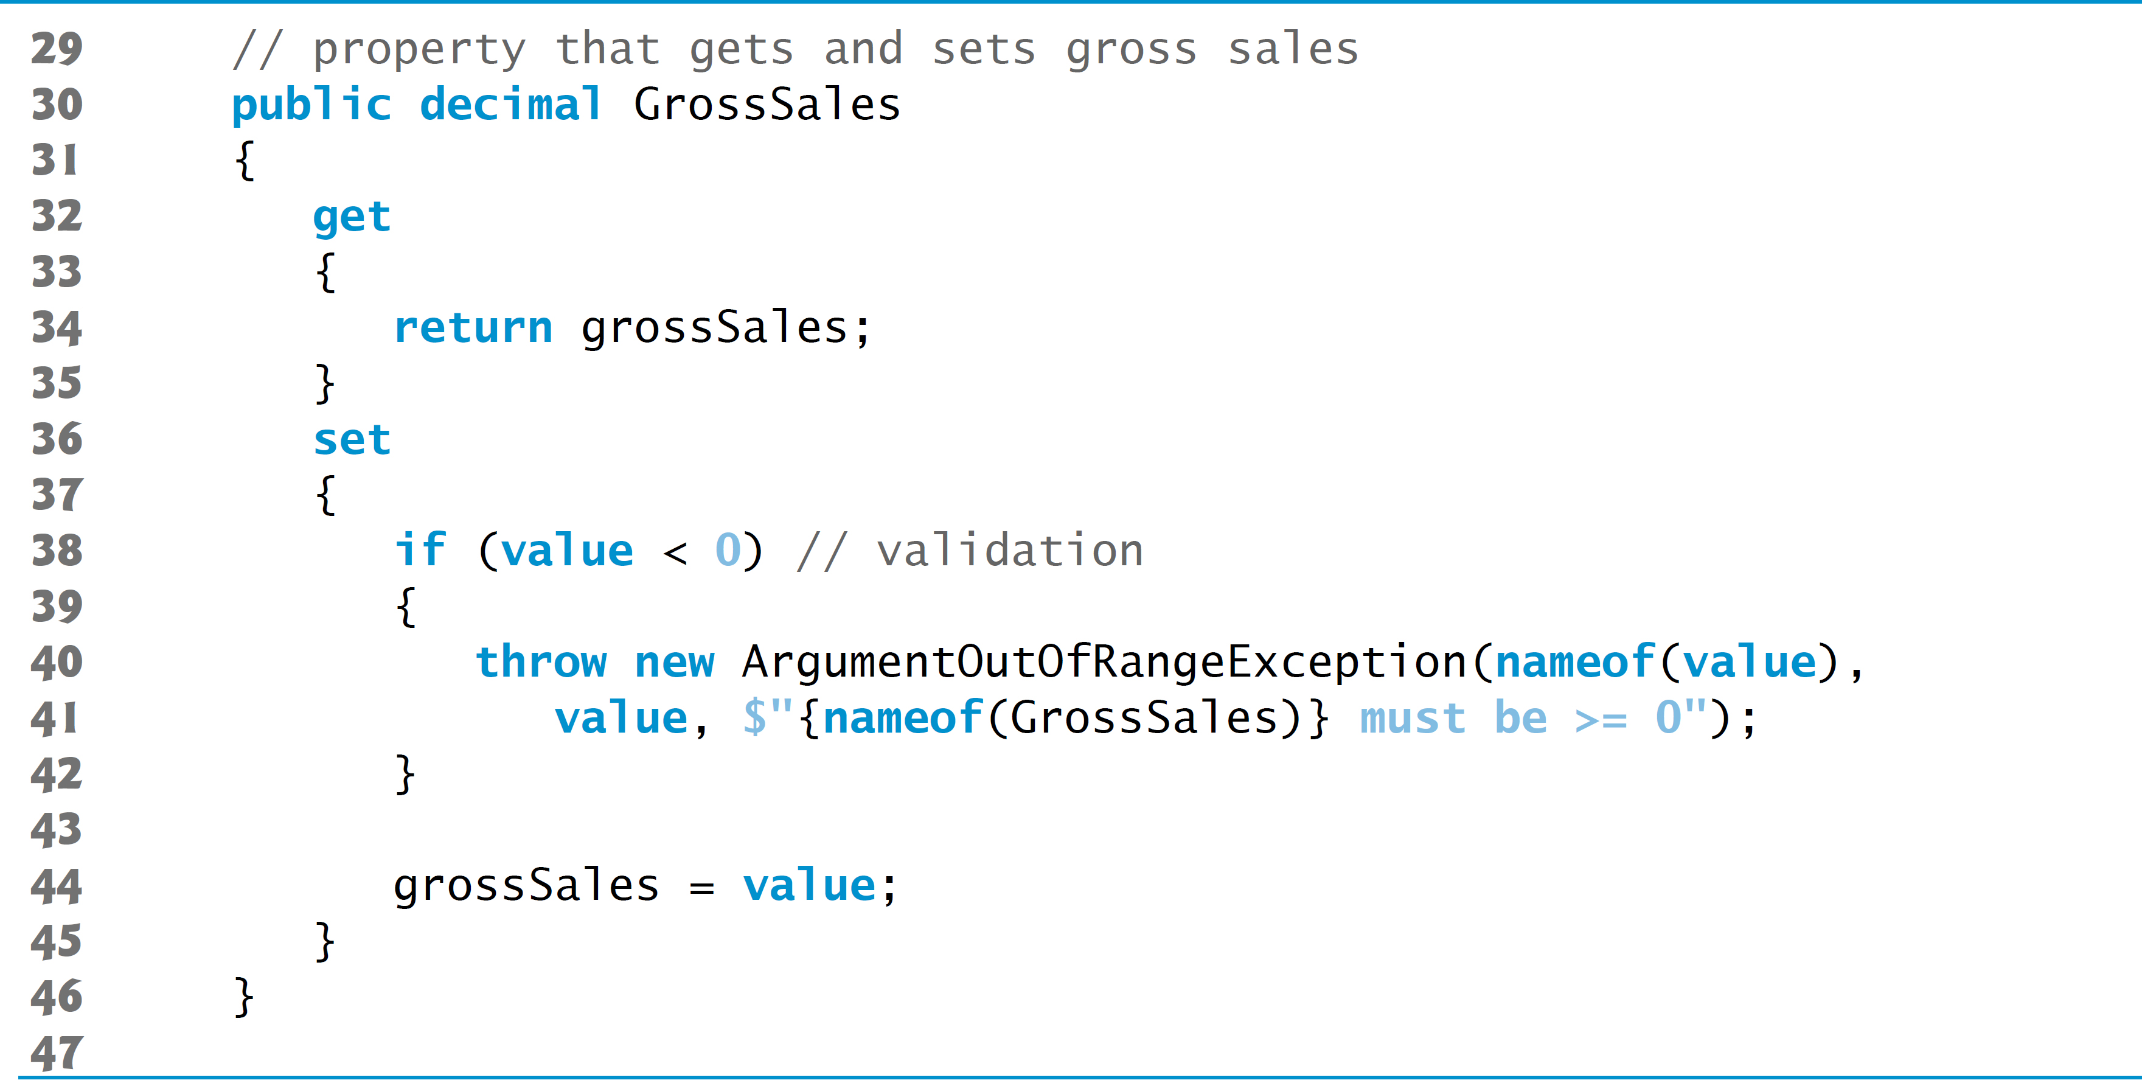
Figure 11.6 BasePlusCommissionEmployee Class Represents an Employee that Receives a Base Salary in Addition to a Commission (3 of 6)

Slide 36
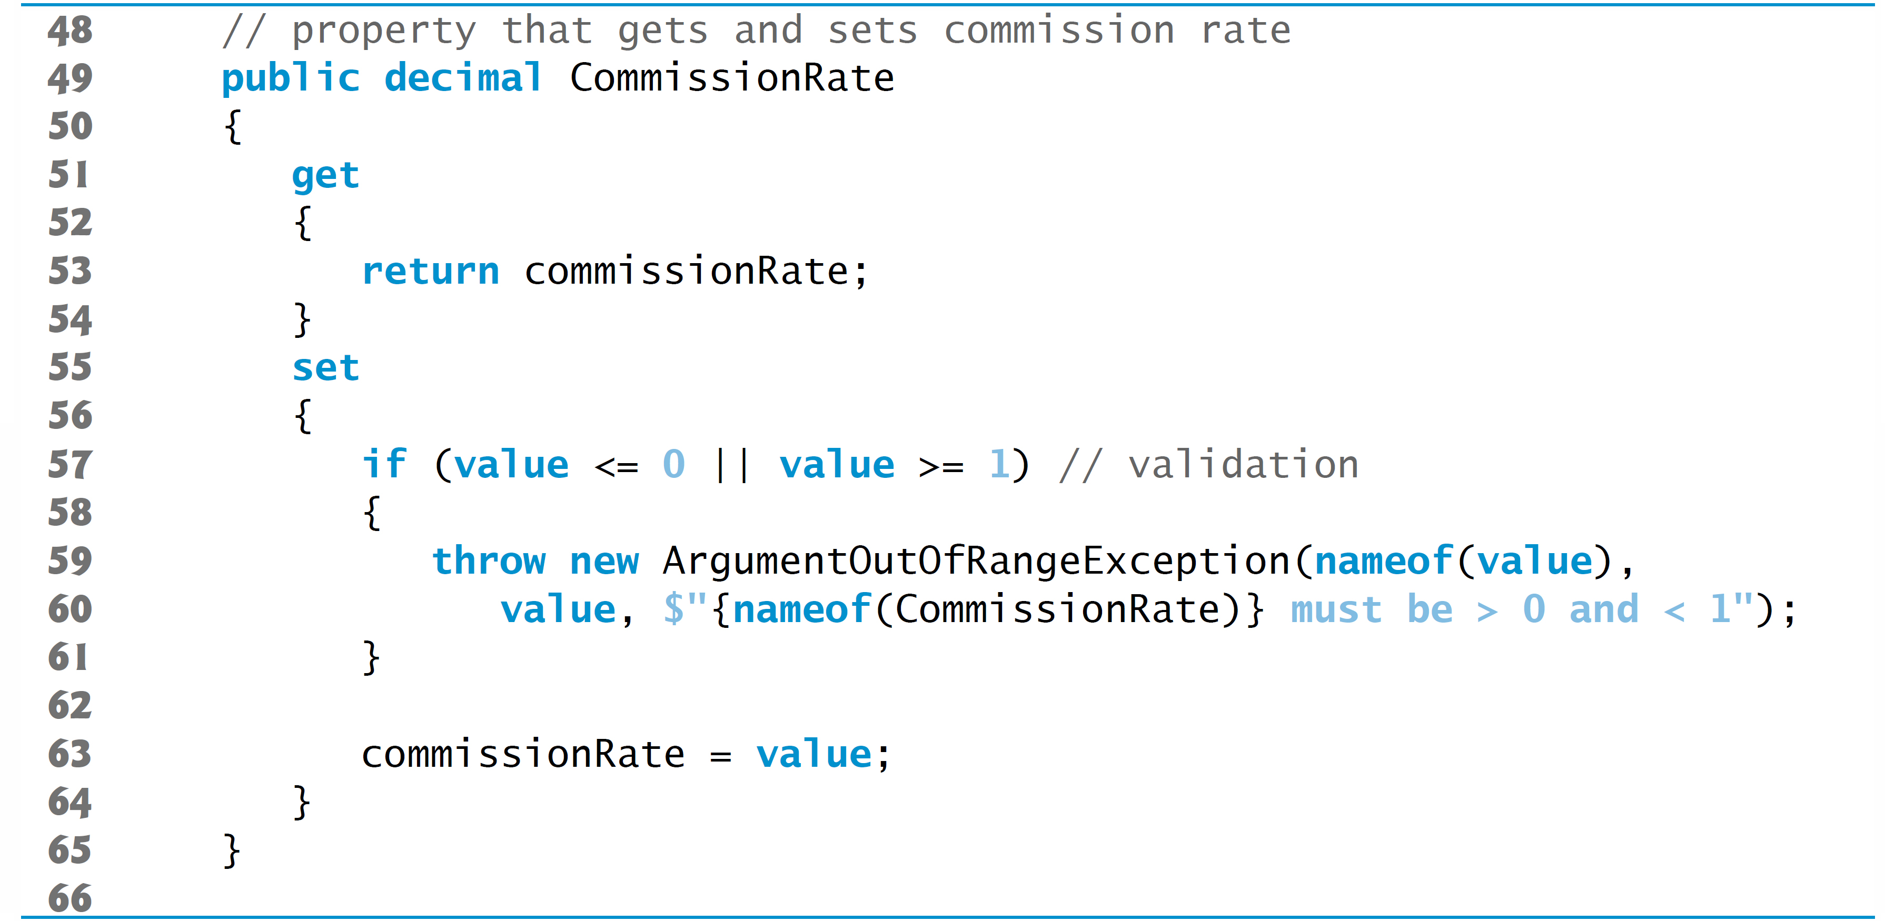
Figure 11.6 BasePlusCommissionEmployee Class Represents an Employee that Receives a Base Salary in Addition to a Commission (4 of 6)

Slide 37
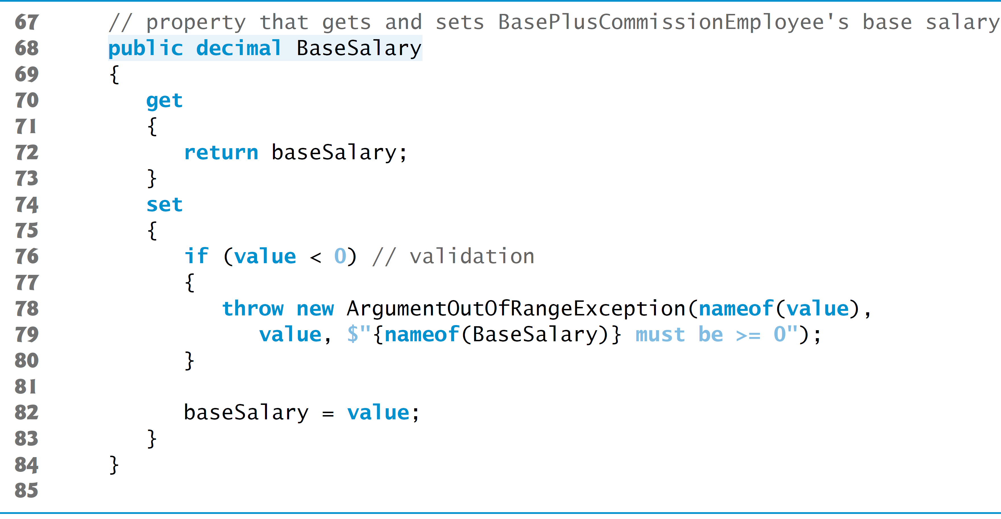
Figure 11.6 BasePlusCommissionEmployee Class Represents an Employee that Receives a Base Salary in Addition to a Commission (5 of 6)

Slide 38
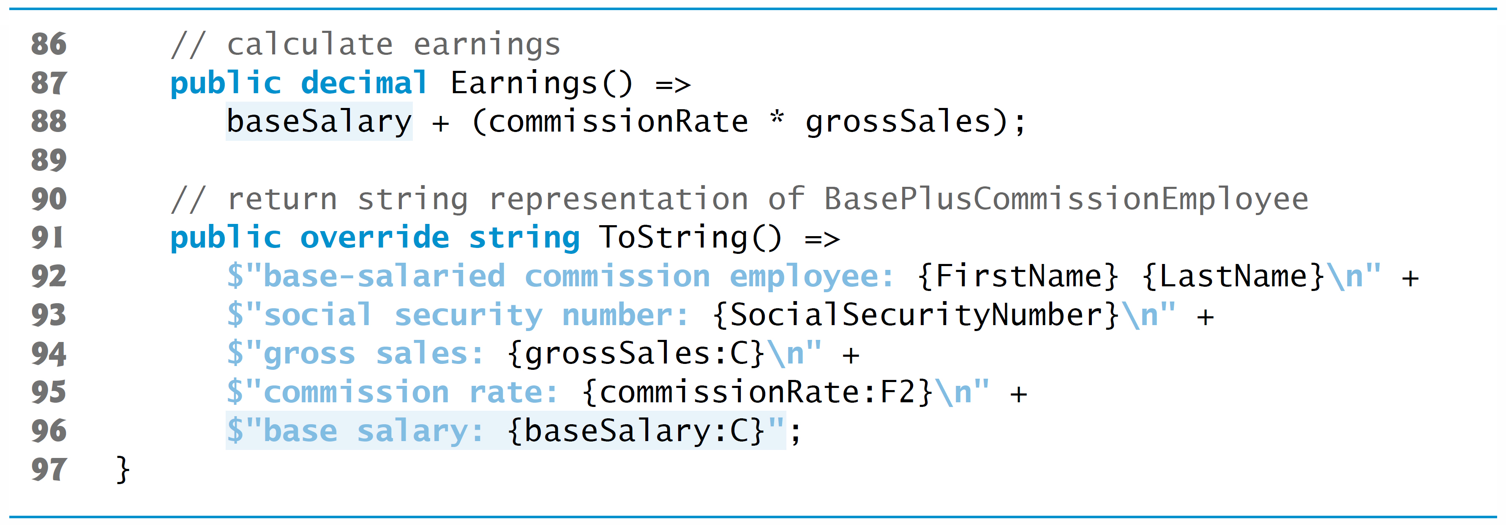
Figure 11.6 BasePlusCommissionEmployee Class Represents an Employee that Receives a Base Salary in Addition to a Commission (6 of 6)

Slide 39
11.4.2 Creating a BasePlusCommissionEmployee Class without Using Inheritance (2 of 3)
Note the similarity between this class and class Commission­Employee (Figure 11.4)—in this example, we do not yet exploit that similarity.
Class BasePlusCommissionEmployeeTest
Figure 11.7 tests class BasePlusCommissionEmployee.

Slide 40
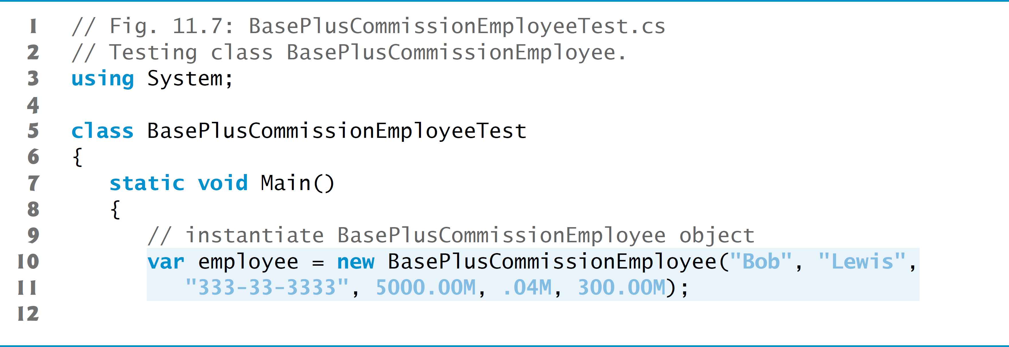
Figure 11.7 Testing Class BasePlusCommissionEmployee (1 of 3)

Slide 41
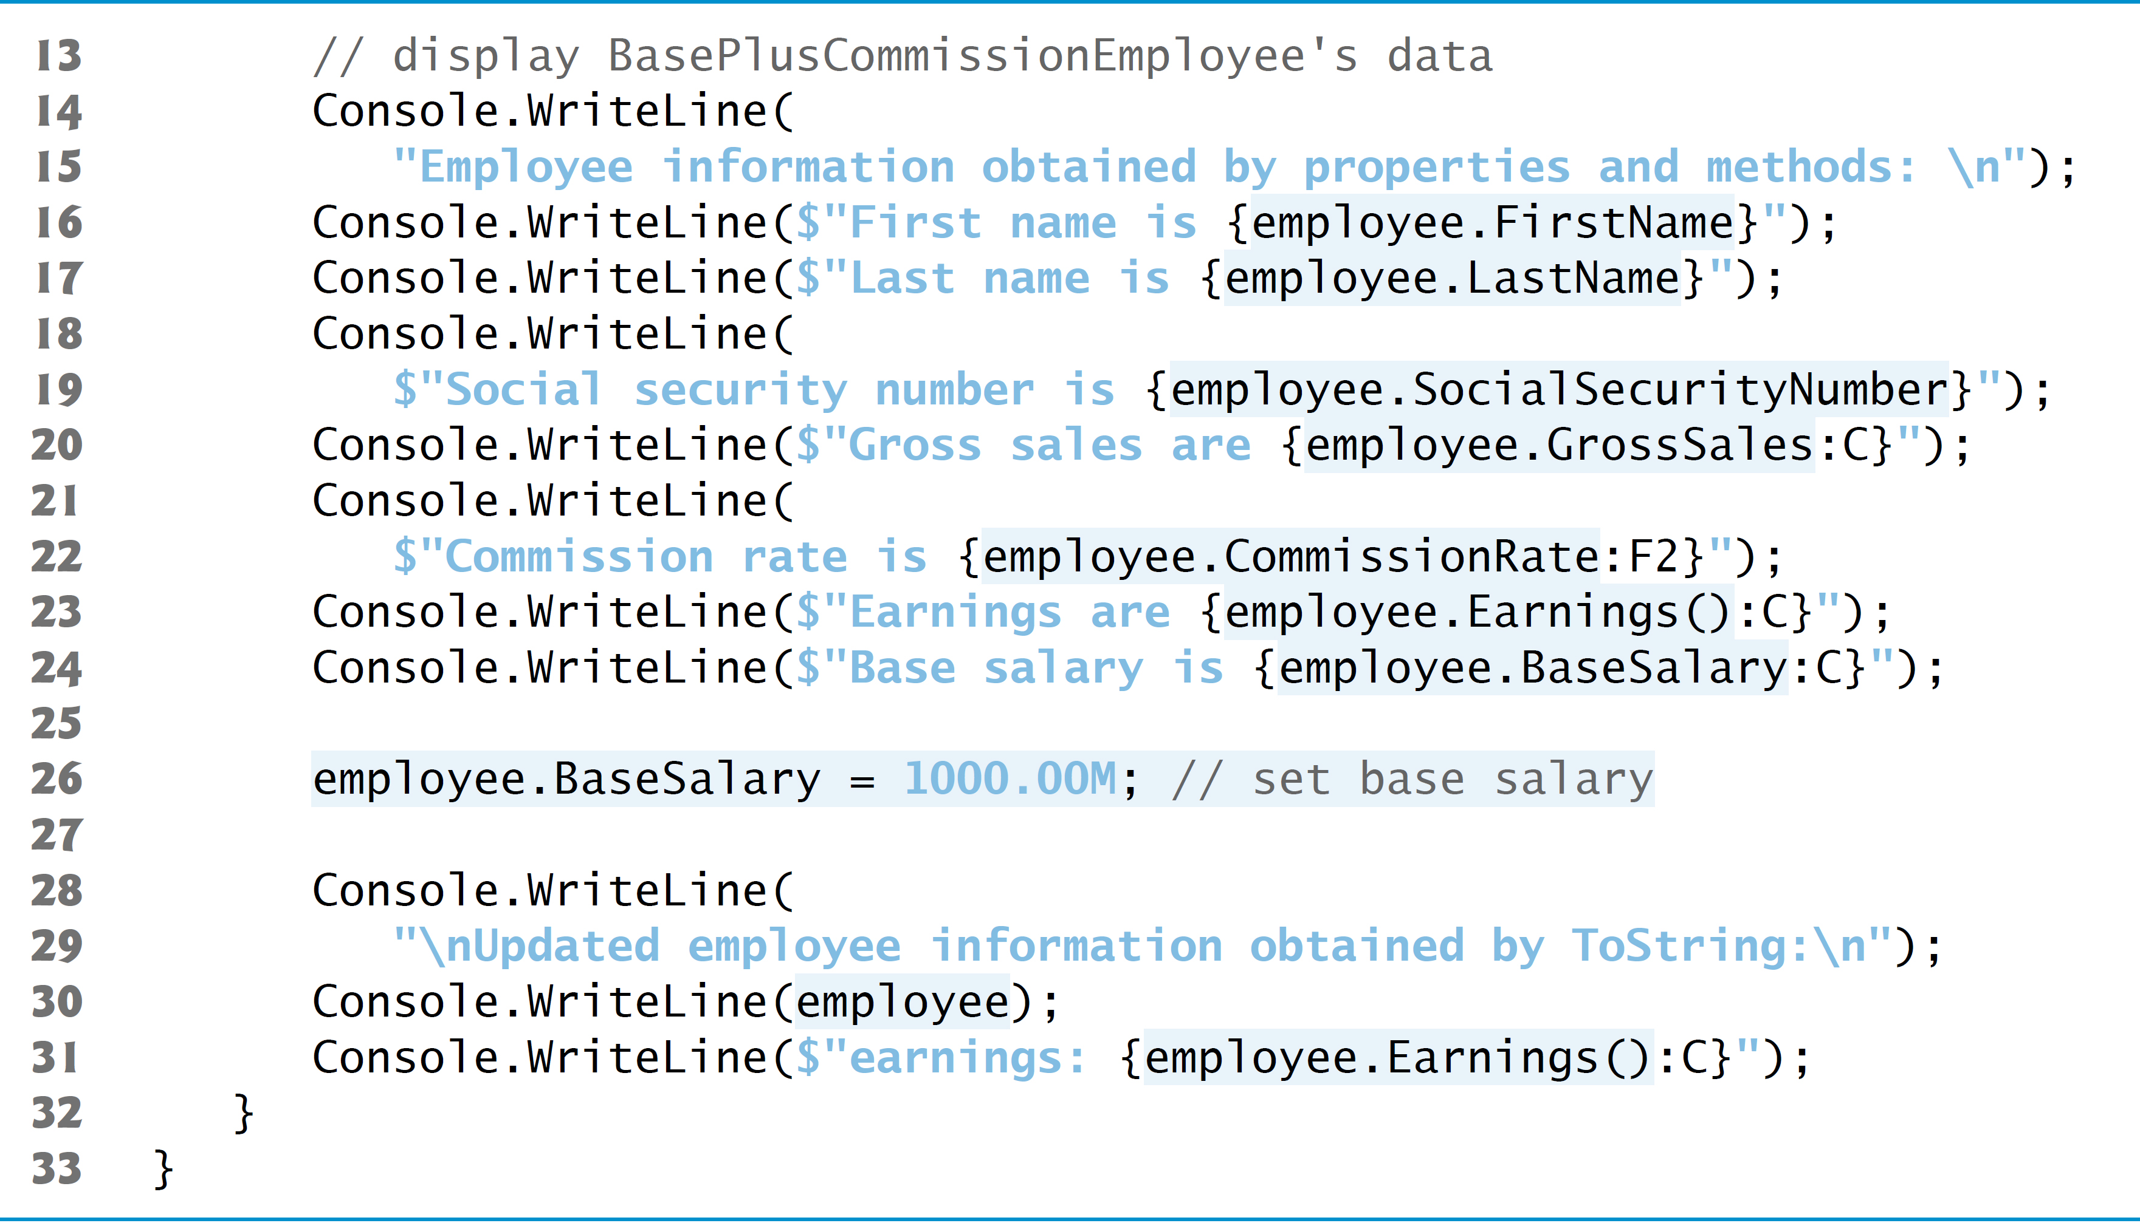
Figure 11.7 Testing Class BasePlusCommissionEmployee (2 of 3)

Slide 42
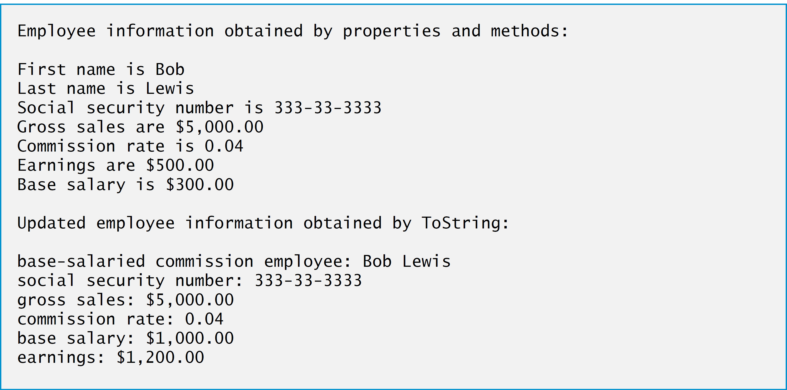
Figure 11.7 Testing Class BasePlusCommissionEmployee (3 of 3)

Slide 43
11.4.2 Creating a BasePlusCommissionEmployee Class without Using Inheritance (3 of 3)
Much of the code for BasePlusCommissionEmployee is similar, if not identical, to the code for CommissionEmployee.

Slide 44
Error-Prevention Tip 11.1
Copying and pasting code from one class to another can spread errors across multiple source-code files. To avoid duplicating code (and possibly errors) in situations where you want one class to “absorb” the members of another class, use inheritance rather than the “copy-and-paste” approach.

Slide 45
Software Engineering Observation 11.3
With inheritance, the common members of all the classes in the hierarchy are declared in a base class. When changes are required for these common features, you need to make the changes only in the base class—derived classes then inherit the changes. Without inheritance, changes would need to be made to all the source-code files that contain a copy of the code in question.

Slide 46
11.4.3 Creating a CommissionEmployee–BasePlusCommissionEmployee Inheritance Hierarchy (1 of 4)
Now we declare class BasePlusCommissionEmployee (Figure 11.8), which extends class CommissionEmployee (Figure 11.4).

Slide 47
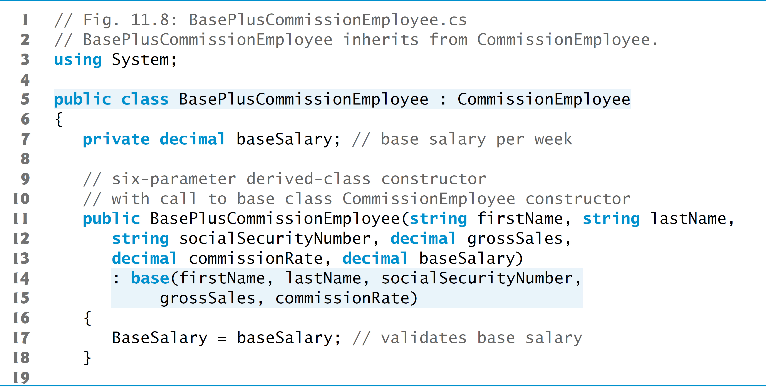
Figure 11.8 BasePlusCommissionEmployee Inherits from CommissionEmployee (1 of 4)

Slide 48
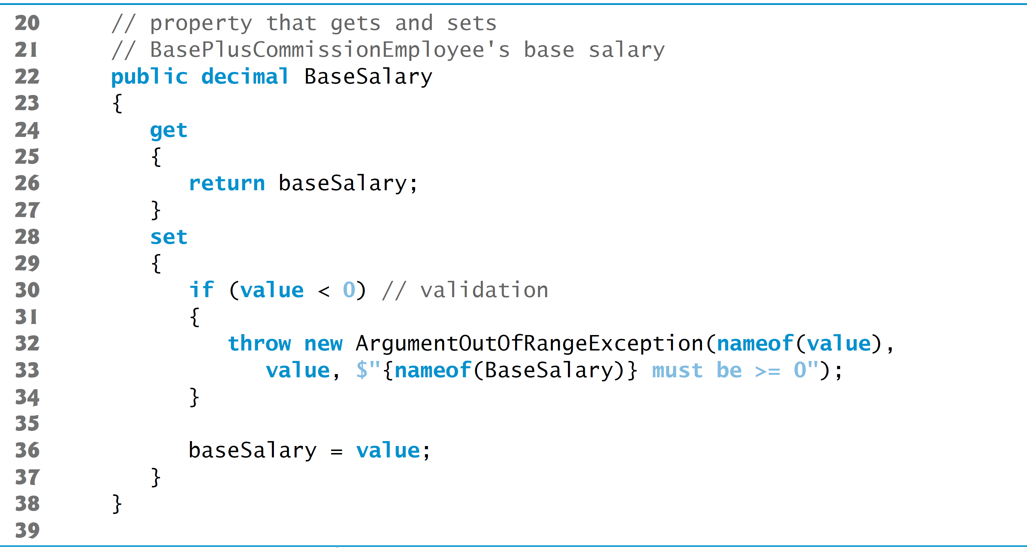
Figure 11.8 BasePlusCommissionEmployee Inherits from CommissionEmployee (2 of 4)

Slide 49
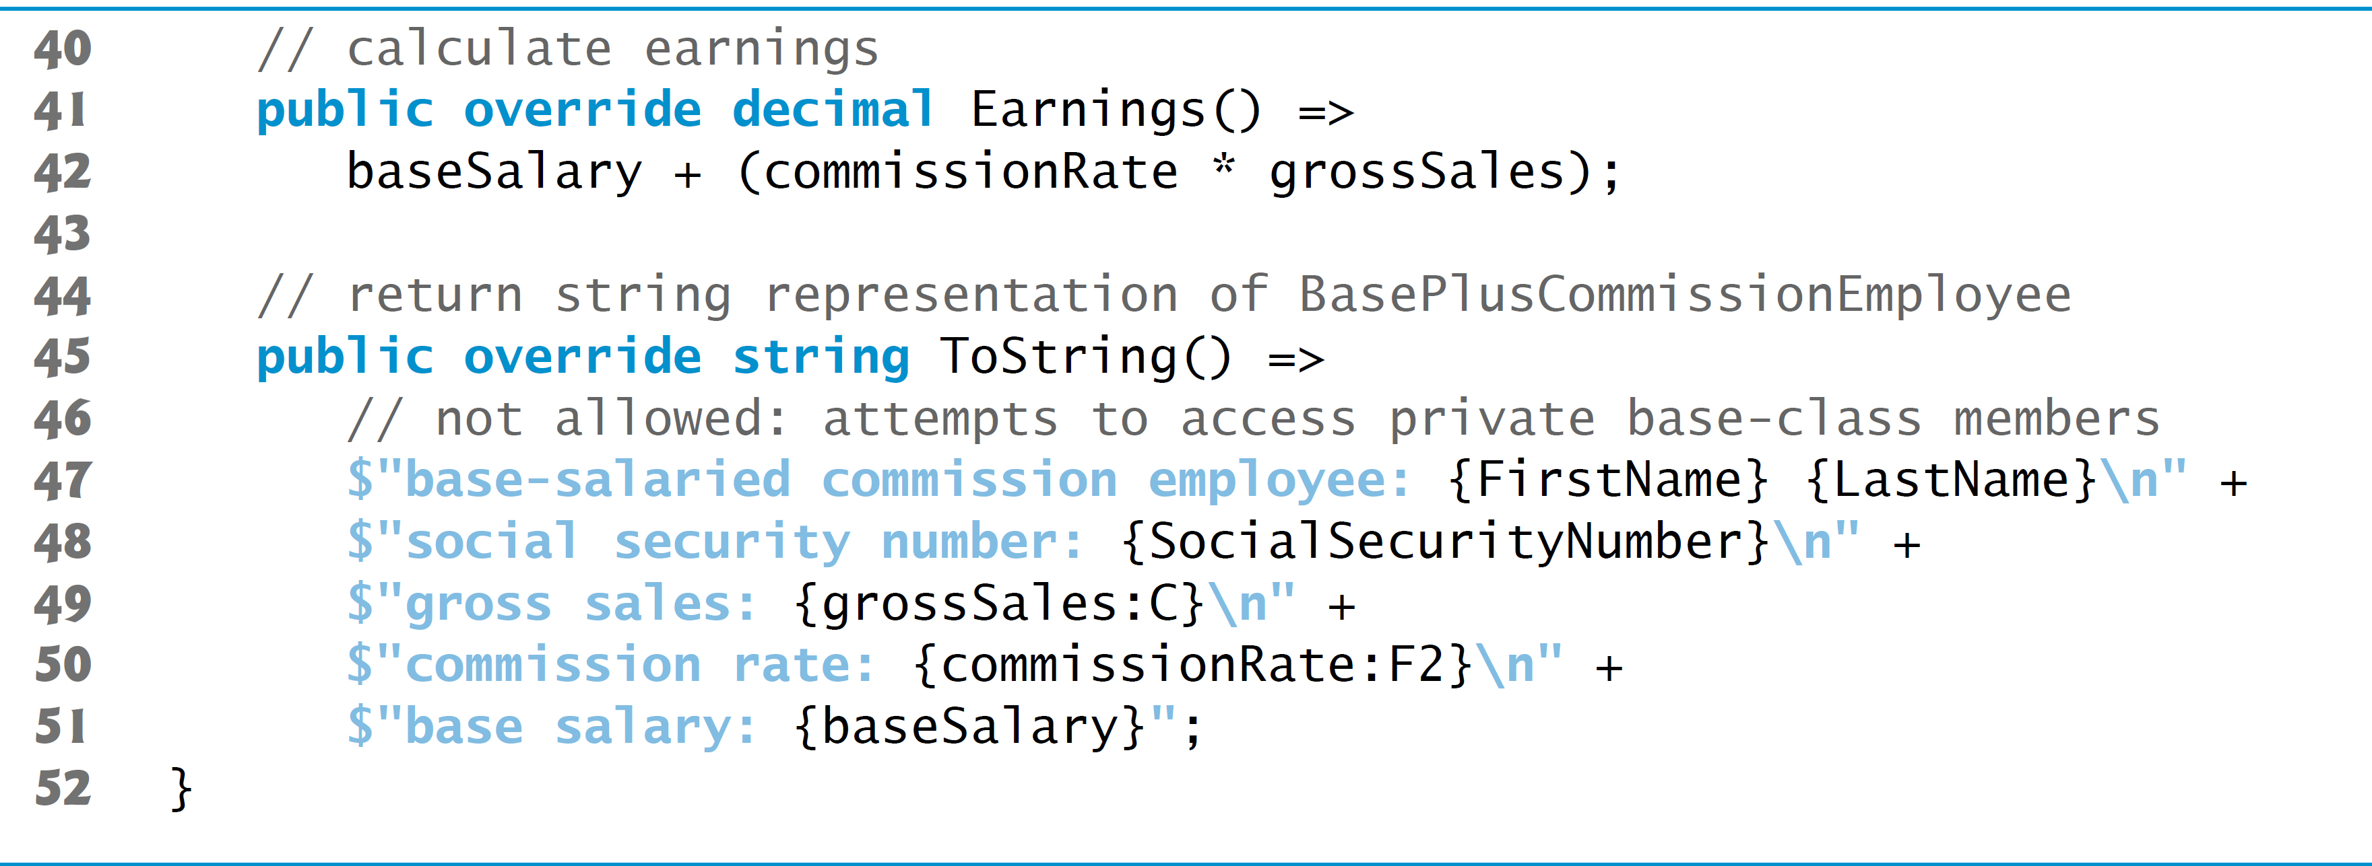
Figure 11.8 BasePlusCommissionEmployee Inherits from CommissionEmployee (3 of 4)

Slide 50
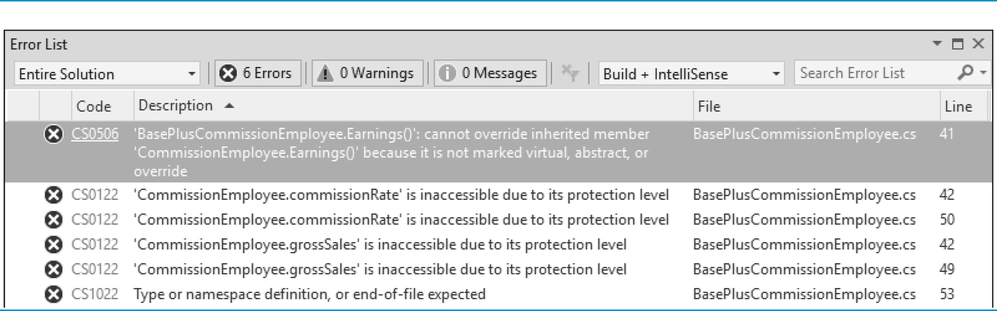
Figure 11.8 BasePlusCommissionEmployee Inherits from CommissionEmployee (4 of 4)

Slide 51
11.4.3 Creating a CommissionEmployee–BasePlusCommissionEmployee Inheritance Hierarchy (2 of 4)
A BasePlusCommissionEmployee object is a CommissionEmployee.
Each derived-class constructor must implicitly or explicitly call its base-class constructor to ensure that the instance variables inherited from the base class are initialized properly.
A constructor initializer with keyword base invokes the base-class constructor.

Slide 52
Common Programming Error 11.2
A compilation error occurs if a derived-class constructor calls one of its base-class constructors with arguments that do not match the number and types of parameters specified in one of the base-class constructor declarations.

Slide 53
11.4.3 Creating a CommissionEmployee–BasePlusCommissionEmployee Inheritance Hierarchy (3 of 4)
BasePlusCommissionEmployee Method Earnings
The virtual and abstract keywords indicate that a base-class method can be overridden in derived classes.
The override modifier declares that a derived-class method overrides a virtual or abstract base-class method.
This modifier also implicitly declares the derived-class method virtual.
We need to declare CommissionEmployee’s Earnings method virtual.

Slide 54
11.4.3 Creating a CommissionEmployee–BasePlusCommissionEmployee Inheritance Hierarchy (4 of 4)
The compiler generates additional errors because base class CommissionEmployee’s instance variables are private.
The errors can be prevented by using the public properties inherited from class CommissionEmployee.

Slide 55
11.4.4 CommissionEmployee–BasePlusCommissionEmployee Inheritance Hierarchy Using protected Instance Variables (1 of 2)
For the next example, we made class CommissionEmployee’s instance variables protected.
We also declared the Earnings method virtual so that BasePlusCommissionEmployee can override the method.
Class BasePlusCommissionEmployee (Figure 11.9) extends the version of class CommissionEmployee with protected data rather than the one with private data in Figure 11.4.
Because the instance variables are now protected, the compiler does not generate errors.

Slide 56
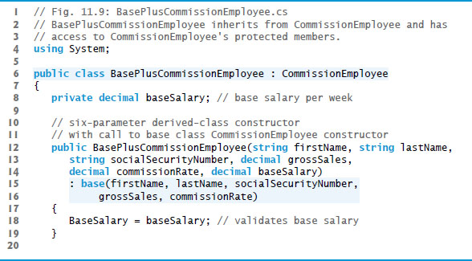
Figure 11.9 BasePlusCommissionEmployee Inherits from CommissionEmployee and has Access to CommissionEmployee’s protected Members (1 of 3)

Slide 57
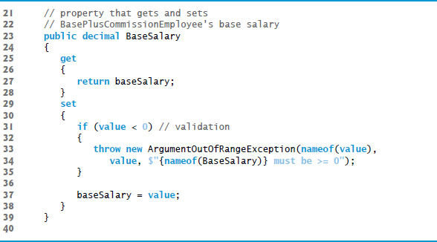
Figure 11.9 BasePlusCommissionEmployee Inherits from CommissionEmployee and has Access to CommissionEmployee’s protected Members (2 of 3)

Slide 58
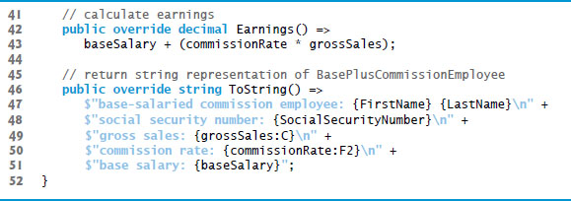
Figure 11.9 BasePlusCommissionEmployee Inherits from CommissionEmployee and has Access to CommissionEmployee’s protected Members (3 of 3)

Slide 59
11.4.4 CommissionEmployee–BasePlusCommissionEmployee Inheritance Hierarchy Using protected Instance Variables (2 of 2)
Class BasePlusCommissionEmployeeTest
The BasePlusCommissionEmployeeTest class in this example’s project is identical to that of and produces the same output, so we do not show the code here.
Although the version of class BasePlusCommissionEmployee in Figure 11.6 does not use inheritance and the version in Figure 11.9 does, both classes provide the same functionality.
The source code in Figure 11.9 is considerably shorter than that in Figure 11.6, because a large portion of the class’s functionality is now inherited from CommissionEmployee.
This makes the code easier to maintain, modify and debug, because the code related to a CommissionEmployee exists only in that class.

Slide 60
11.4.5 CommissionEmployee–BasePlusCommissionEmployee Inheritance Hierarchy Using private Instance Variables (1 of 5)
Using protected instance variables creates several potential problems.
The derived-class object can set an inherited variable’s value directly without validity checking.
Derived-class methods would need to be written to depend on the base class’s data implementation.
You should be able to change the base-class implementation while still providing the same services to the derived classes.

Slide 61
Software Engineering Observation 11.4
Declaring base-class instance variables private (as opposed to protected) enables the baseclass implementation of these instance variables to change without affecting derived-class implementations.

Slide 62
11.4.5 CommissionEmployee–BasePlusCommissionEmployee Inheritance Hierarchy Using private Instance Variables (2 of 5)
Class CommissionEmployee (Figure 11.10) declares private instance variables and provide public properties.

Slide 63
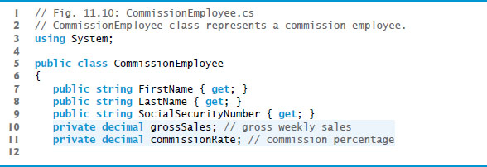
Figure 11.10 CommissionEmployee Class Represents a Commission Employee (1 of 5)

Slide 64
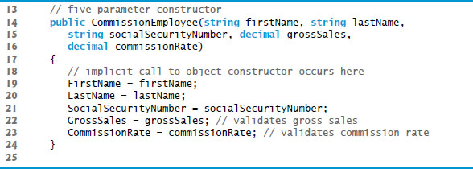
Figure 11.10 CommissionEmployee Class Represents a Commission Employee (2 of 5)

Slide 65
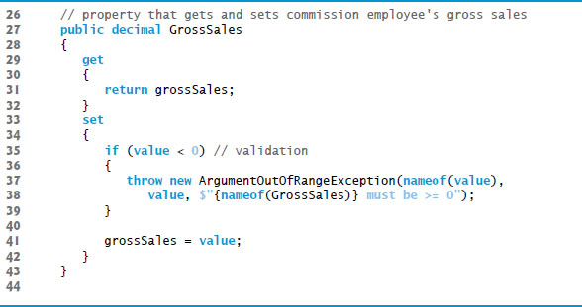
Figure 11.10 CommissionEmployee Class Represents a Commission Employee (3 of 5)

Slide 66
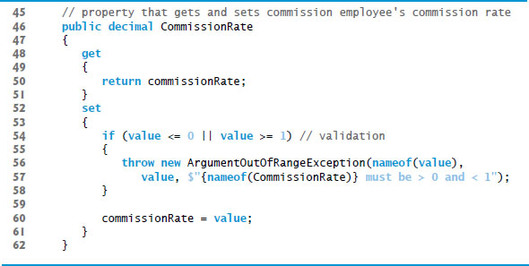
Figure 11.10 CommissionEmployee Class Represents a Commission Employee (4 of 5)

Slide 67
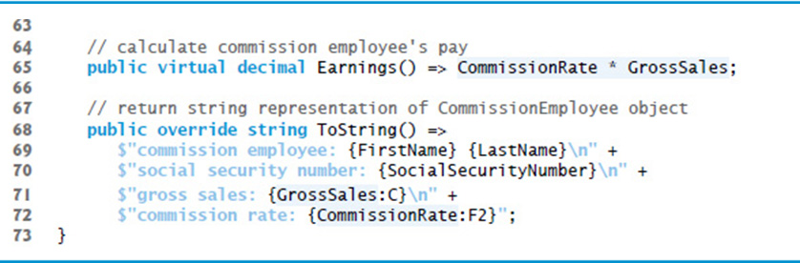
Figure 11.10 CommissionEmployee Class Represents a Commission Employee (5 of 5)

Slide 68
11.4.5 CommissionEmployee–BasePlusCommissionEmployee Inheritance Hierarchy Using private Instance Variables (3 of 5)
Class BasePlusCommissionEmployee (Figure 11.11) inherits from CommissionEmployee’s and can access the private base-class members via the inherited public properties.

Slide 69
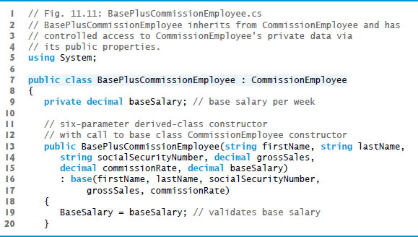
Figure 11.11 BasePlusCommissionEmployee Inherits from CommissionEmployee and has Access to CommissionEmployee’s Private Data via its Public Properties (1 of 3)

Slide 70
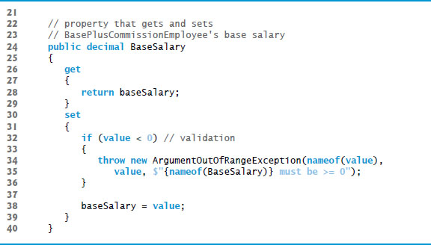
Figure 11.11 BasePlusCommissionEmployee Inherits from CommissionEmployee and has Access to CommissionEmployee’s Private Data via its Public Properties (2 of 3)

Slide 71
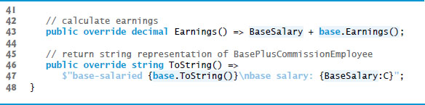
Figure 11.11 BasePlusCommissionEmployee Inherits from CommissionEmployee and has Access to CommissionEmployee’s Private Data via its Public Properties (3 of 3)

Slide 72
11.4.5 CommissionEmployee–BasePlusCommissionEmployee Inheritance Hierarchy Using private Instance Variables (4 of 5)
Class BasePlusCommissionEmployee’s Earnings overrides class CommissionEmployee’s Earnings method.
The new version obtains the portion of the employee’s earnings based on commission alone by calling CommissionEmployee’s Earnings method with the expression base.Earnings()
This method invocation is a good software engineering practice—by having BasePlusCommissionEmployee’s Earnings method invoke CommissionEmployee’s Earnings method to calculate part of a BasePlusCommissionEmployee object’s earnings, we avoid duplicating the code and reduce code-maintenance problems

Slide 73
Common Programming Error 11.3
When a base-class method is overridden in a derived class, the derived-class version often calls the base-class version to do a portion of the work. Failure to prefix the base-class method name with the keyword base and the member access (·) operator when referencing the base class’s method from the derived-class version causes the derived-class method to call itself, creating infinite recursion.

Slide 74
11.4.5 CommissionEmployee–BasePlusCommissionEmployee Inheritance Hierarchy Using private Instance Variables (5 of 5)
Class BasePlusCommissionEmployeeTest
Class BasePlusCommissionEmployeeTest performs the same manipulations on a BasePlusCommissionEmployee object as in Figures 11.7 and produces the same output, so we do not show it here.

Slide 75
11.5 Constructors in Derived Classes
The derived-class constructor, before performing its own tasks, invokes its direct base class’s constructor.
This is done either explicitly or implicitly.
If the base class is derived from another class, the base-class constructor invokes the constructor of the next class up in the hierarchy, and so on.

Slide 76
11.6 Software Engineering with Inheritance (1 of 2)
When a new class extends an existing class, the new class inherits the members of the existing class.
We can customize the new class to meet our needs by including additional members and by overriding base-class members.
Independent software vendors (I S V s) can develop and sell proprietary classes.
Users then can derive new classes from these library classes without accessing the source code.

Slide 77
Software Engineering Observation 11.5
Although inheriting from a class does not require access to the class’s source code, developers often insist on seeing the source code to understand how the class is implemented. They may, for example, want to ensure that they’re extending a class that performs well and is implemented securely.

Slide 78
11.6 Software Engineering with Inheritance (2 of 2)
Effective software reuse improves the software-development process.
Object-oriented programming facilitates software reuse, potentially shortening development time.
The availability of substantial and useful class libraries helps deliver the maxi­mum benefits of software reuse through inheritance.

Slide 79
Software Engineering Observation 11.6
At the design stage in an object-oriented system, the designer often finds that certain classes are closely related. The designer should “factor out” common members and place them in a base class. Then the designer should use inheritance to develop derived classes, specializing them with capabilities beyond those inherited from the base class.

Slide 80
Software Engineering Observation 11.7
Declaring a derived class does not affect its base class’s source code. Inheritance preserves the integrity of the base class.

Slide 81
11.7 Class object
All classes inherit directly or indirectly from the object class.
Figure 11.12 summarizes object’s methods.

Slide 82
Figure 11.12 object Methods that are Inherited Directly or Indirectly by All Classes (1 of 4)
Method | Description
Equals | This method compares the current object to another object for equality and returns true if they’re equal and false otherwise. It takes any object as an argument. When objects of a particular class must be compared for equality, the class should override method Equals to compare the contents of the two objects. The website http://bit.ly/OverridingEquals C Sharp explains the requirements for a properly overridden Equals method.

Slide 83
Figure 11.12 object Methods that are Inherited Directly or Indirectly by All Classes (2 of 4)
Method | Description
Finalize | This method cannot be explicitly declared or called. When a class contains a destructor, the compiler implicitly renames it to override the protected method Finalize, which is called only by the garbage collector before it reclaims an object’s memory. The garbage collector is not guaranteed to reclaim an object, thus it’s not guaranteed that an object’s Finalize method will execute. When a derived class’s Finalize method executes, it performs its task, then invokes the base class’s Finalize method. In general, you should avoid using Finalize.

Slide 84
Figure 11.12 object Methods that are Inherited Directly or Indirectly by All Classes (3 of 4)
Method | Description
GetHashCode | A hashtable data structure relates objects, called keys, to corresponding objects, called values. We discuss Hashtable in Chapter 21. When a value is initially inserted in a hashtable, the key’s GetHashCode method is called. The value returned is used by the hashtable to determine the location at which to insert the corresponding value. The key’s hashcode is also used by the hashtable to locate the key’s corresponding value.
GetType | Every object knows its own type at execution time. Method GetType (used in Section 12.5) returns an object of class Type (namespace System) that contains information about the object’s type, such as its class name (obtained from Type property FullName).

Slide 85
Figure 11.12 object Methods that are Inherited Directly or Indirectly by All Classes (4 of 4)
Method | Description
MemberwiseClone | This protected method, which takes no arguments and returns an object reference, makes a copy of the object on which it’s called. The implementation of this method performs a shallow copy—instance-variable values in one object are copied into another object of the same type. For reference types, only the references are copied.
ReferenceEquals | This static method receives two object references and returns true if they’re the same instance or if they’re null references. Otherwise, it returns false.
ToString | This method (introduced in Section 7.4) returns a string representation of the current object. The default implementation of this method returns the namespace followed by a dot and the class name of the object’s class.

Slide 86

Copyright

